Slide 1
CINEMA TICKET BOOKING SYSTEM
DEPARTMENT: EEE
YEAR:2024 - 2025
TEAM: ROLL NO:
Siddana gouda Y 49
Mohammed umar Farooq 57
V Srinivas 61
Vidya NH 58
Ajay kumar K 19

Slide 2
CONTENTS​
Abstract
Objective of the project
Domaine of the project
Problem statement
Project overview
Key features of project
Technologies Used
System workflow
Code implementation
Conclusion

Slide 3
ABSTRACTS
The Cinema Ticket Booking System is a web-based application designed to streamline the process of reserving and purchasing tickets for movies.
It provides users with an interface to browse movie schedules, select seats, and complete transactions securely.

Slide 4
OBJECTIVE OF THE PROJECT
Real-Time Seat Availability:To implement a system that provides real-time updates on seat availability, allowing users to select their preferred seats without confusion.
Secure Payment Processing:To integrate secure payment gateways that support various payment methods, ensuring safe and efficient transactions.

Slide 5
Domain of the project
application

Slide 6
Problem Statement
Develop a including ticket booking system that allows users to easily search, select, and purchase tickets for various events (such as concerts, movies, sports, and theater) while providing an efficient backend for administrators to manage events and bookings.

Slide 7
PROJECT OVERVIEW
This overview provides a comprehensive framework for developing an efficient cinema ticket booking system aimed at improving user experience and operational efficiency.

Slide 8
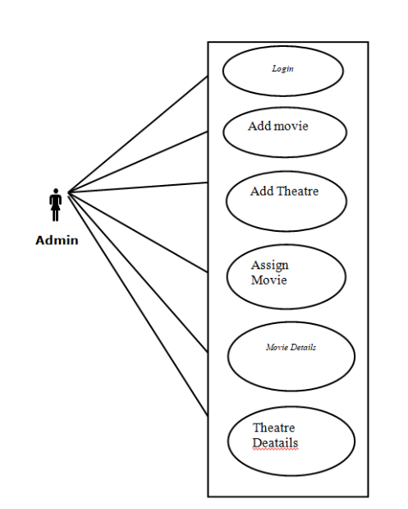
Key Features Of Project

Slide 9
Technologies Used
We used python programming to develop a program . it is a general purpose and high level programming language

Slide 10
SYSTEM WORKFLOW
The workflow of the Cinema Ticket Booking System is designed to guide users
through the process of booking cinema tickets seamlessly. Below is a detailed
outline of the system's workflow:
INITILIZATION:
User inputs cinema name and total seats. System creates a cinema instance.
MAIN BOOKING LOOP:
Display available seats . Prompt user to enter number of tickets to book (or to
exit).

Slide 11
CODE IMPELMENTATION
class Cinema:
def __init__
def book_ticket(self, num_tickets):
if
def available_seats(self):
return self.total_seats - self.booked_seats
def main():
while True:
if num_tickets == 0:
print("Thank you for using the cinema ticket booking system!")
break
if __name__=="__main__":
main()

Slide 12
CONCLUSION
concluInsion, cinema ticket booking has evolved significantly, embracing digital advancements to enhance the customer experience. With online platforms and mobile apps, the process has become more convenient and efficient, allowing moviegoers to easily select showtimes, choose seats, and make secure payments. This evolution not only streamlines the experience but also provides valuable data to theaters for better audience engagement and personalized marketing. As technology continues to advance, we can expect further innovations in ticket booking that will enrich the cinematic experience even more. Whether through loyalty programs, dynamic pricing, or enhanced user interfaces, the future of cinema ticket booking looks promising.

Slide 13
Thank you

